Slide 1



Hadoop Tutorial
Writable Data Types in Hadoop

Slide 2

Hadoop Writable Data Types
A data type is a set of data with values having predefined characteristics. There are several kinds of data types in Java. For example- int, short, byte, long, char etc.
Similarly Hadoop has its own equivalent data types called Writable data types.
These Writable data types are passed as parameters (input and output key-value pairs) for the mapper and reducer.
Writable is an interface in Hadoop.
Writable in Hadoop acts as a wrapper class to almost all the primitive data type of Java. That is how int of java has become IntWritable in Hadoop and String of Java has become Text in Hadoop.

Slide 3
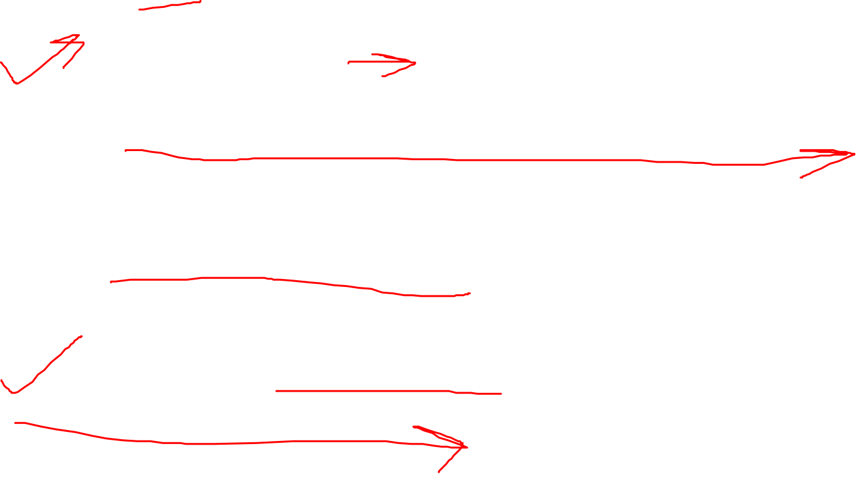
Why Writable in Hadoop
Hadoop framework needs Writable type of interface in order to perform the following tasks:
Implement serialization.
Transfer data between clusters and networks.
Store the deserialized data in the local disk of the system.
Writable is a strong interface in Hadoop which while serializing the data, reduces the data size enormously, so that data can be exchanged easily within the networks.
It has separate read and write fields to read data from network and write data into local disk respectively.

Slide 4

Question : why Hadoop does not use java serialization
Why Writable in Hadoop :
Compact Serialization by Writable :
java serialization is bulky, Hadoop serialization through Writable, reduces the data size enormously.
If the size of serialized data in Hadoop is like that of Java, then it will become an overhead in the network.
If Writable is not present in Hadoop, then it uses the serialization of Java which increases the data over-head in the network.
Random Read Write Access
Another reason to have writable data type provide the random read write access, which is required to partition and distribute the data on the cluster.

Slide 5
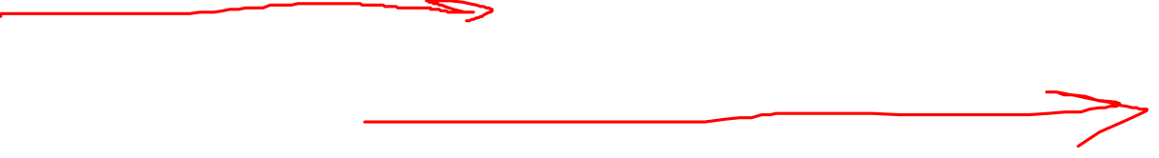
Hadoop Writable Data Types
There are two interfaces provided in the Hadoop for Writables:
Writable
WritableComparable
Note : All the keys in Hadoop, need to implement WritableComparable interface, as during sorting and shuffling phase, keys need to be compared
and all the values need to implement Writable interface.
public interface Writable {
void readFields(DataInput in);
void write(DataOutput out);
}
public interface WritableComparable extends Writable, Comparable
{
void readFields(DataInput in);
void write(DataOutput out);
int compareTo(WritableComparable o)
}

Slide 6

Hadoop Data Types
List of data types in Java along with the equivalent Hadoop variant:
Integer –> IntWritable: It is the Hadoop variant of Integer. It is used to pass integer numbers as key or value.
Float –> FloatWritable: Hadoop variant of Float used to pass floating point numbers as key or value.
Long –> LongWritable: Hadoop variant of Long data type to store long values.
Short –> ShortWritable: Hadoop variant of Short data type to store short values.
Double –> DoubleWritable: Hadoop variant of Double to store double values.
String –> Text: Hadoop variant of String to pass string characters as key or value.
Byte –> ByteWritable: Hadoop variant of byte to store sequence of bytes.
null –> NullWritable: Hadoop variant of null to pass null as a key or value. Usually NullWritable is used as data type for output key of the reducer, when the output key is not important in the final result.

Slide 7
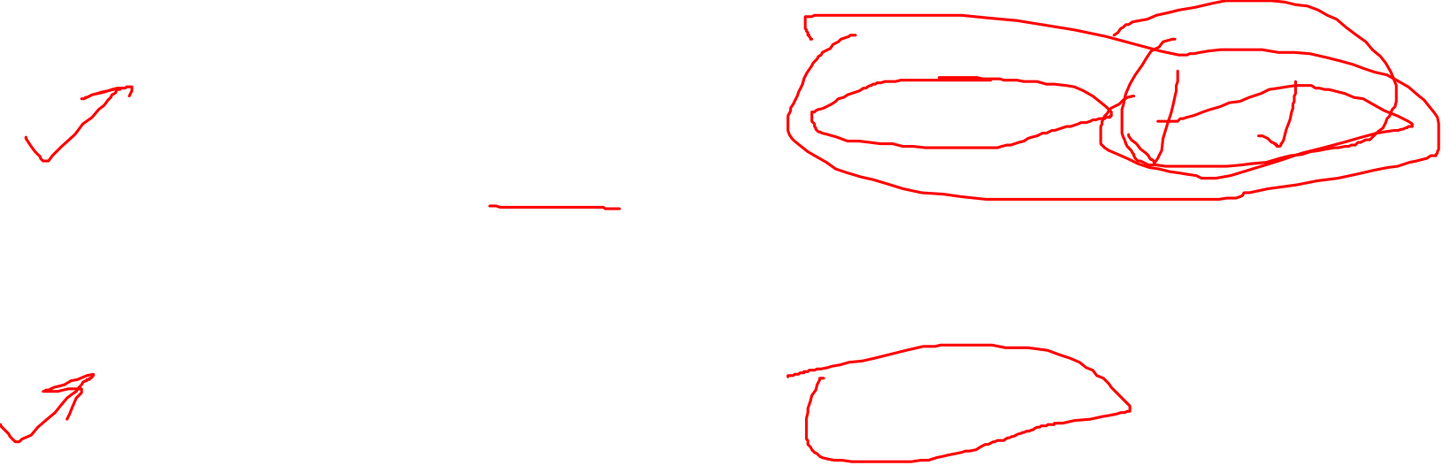
Hadoop Data Types
Example of a Reducer class
public static class wordMapper extends Mapper<LongWritable, Text, Text, IntWritable>
Here the first two data types are input key and value to the map function, will be of long values and string characters respectively. The second two data types are intermediate output key and value from the map function will be string characters and int numbers respectively.
Example of a Reducer class:
public static class wordReducer extends Reducer<Text, IntWritable, NullWritable, Text>
Here the first two data types are input key and value to the reduce function, must match the intermediate key and value from the mapper. The second two data types are output key and value from the reduce function, which will be the final result of the MapReduce program.
Apart from this, we can also write a custom Writable by overriding the write and readFields methods.

Slide 8
Thanks and do subscribe to my channel

